Slide 1
AHSBCA Clinic
Dec. 3, 2022
Infield

Slide 2
Table of Contents
Prep and Field Technique
Middle Infield (SS/2B)
Corner Infield (1B/3B)
Practice Routes
Skill and Drill
Picks
Cone Ground Balls (Footwork)
Middle Infielder (SS/2B)
Corner Infielder (1B/3B)
L Drill
Group
Cut Drill
Triangle Drill
Bucket Feeds
Bucket Feeds and Turns
Team
Fungo
4 corners
Situational Fungo (Competition)
Practice Schedule
Organization

Slide 3
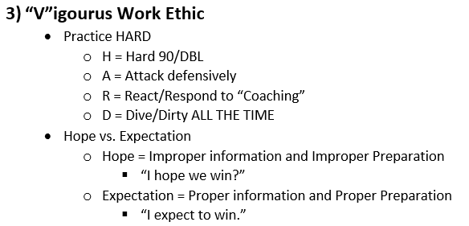
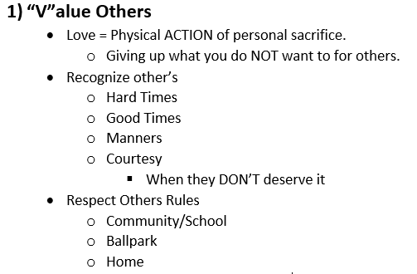
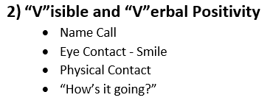
“VTownBoys Way”

Slide 4
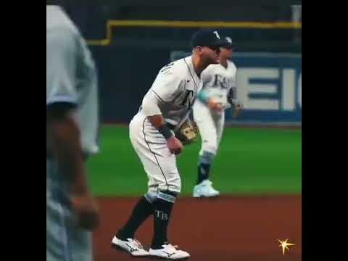
Prep
Prep
“1 - 2 - HOP”
Start MINIMUM of TWO Steps from where you want to finish
HOP - must happen as ball is in the “hitting zone”.
Finish
Arms in position to run
Corner INF = lower
Middle INF = Higher
MUST BE COMFORTABLE TO BREAK

Slide 5
Fielding Technique - Corner INF
“Shuffle Tech”
Ball hit right at us
“1 - 2” Step
“1 Step” = Small side step with “Throwing side” foot and fielder MUST “present the glove”
“2 Step” = Small step towards path of the ball with “Glove side foot” and MUST arrive as the ball is being fielded
Glove, ball, and foot should arrive at the same time.
Cone Ground Balls

Slide 6
Fielding Technique - Middle INF
“V-Cut Tech”
Ball hit right at us
“1 - 2 - 3” Step
“1 Step” = 45 degree angle step with “Glove side” foot and fielder MUST “point should toward the ball”
“2 Step” = Small step across “1 Step” towards path of the ball with “Throwing side foot” and MUST “present the glove”.
“3 Step” = Step with “glove side foot” towards path of the ball with “Glove side foot” and MUST arrive as the ball is being fielded
Glove, ball, and foot should arrive at the same time.
Cone Ground Balls

Slide 7
Practice Routines - Picks and “Fast Five”
Pre-Throwing
Players MUST do 1X10 of each
One Hand
Two Hand
“Baby” Backhand
Extended Backhand
Forehand
“Fast Five”
Players MUST do 2 sets each

Slide 8
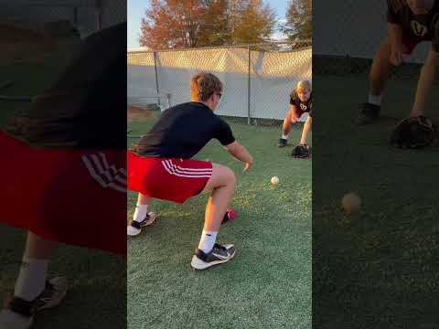
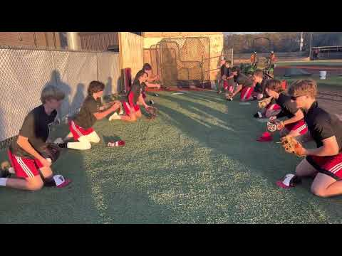
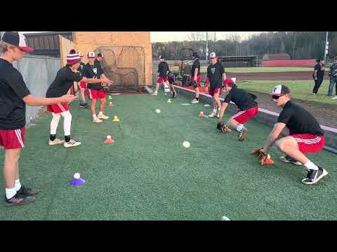
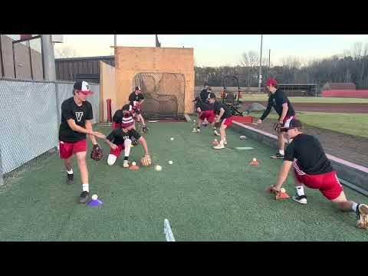
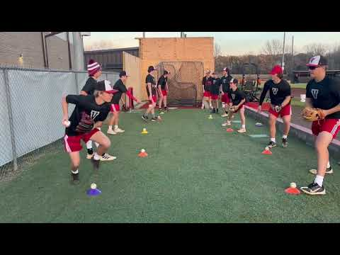
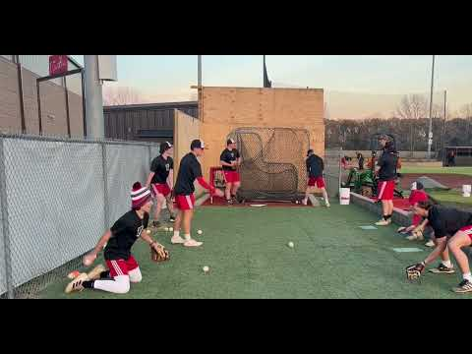
Practice Routines - Pre Throwing

Slide 9
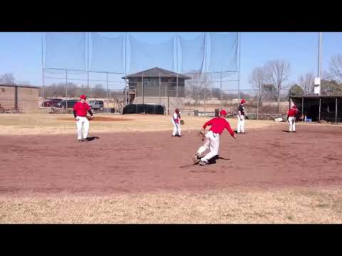
Practice Routines - “L Drill”
Backhand/Forehand Focus
Footwork
Short Throwing
Backhand Focus
“Baby” Backhand
Extended Backhand
Hand on top of the ball.
Forehand Focus
“Rip-it DON’T Flip-it”
Shoulder closed
Inside foot = Rip
Outside foot = Follow

Slide 10
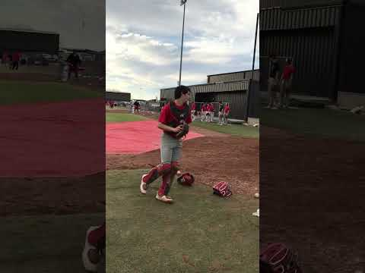
Practice Routines - Group (Cut Drill)
Outfield Cut Throws Focus
Loud Target
Short/Intermediate Throwing
Short Tech
Shorter Throw for the infielder
“Step(to the ball)-Catch-Throw”
Find the arm slot for throw
Corner INF ONLY
Middle INF use as well
Long Tech
Longer throw for the infielder
“Step(with the ball)-Catch-Throw”
Middle INF ONLY

Slide 11
Practice Routines - Group (Triangle Drill)
Infielding and Throwing Focus
Moderate working to intense throwing
Prep Steps or NO ROLL
Misplay NO ROTATION
Wrong roll NO ROTATION
Plays progress to above 90 ft.
Cone distance is 3B to cones
Complete throwing progression.
Rounds = 3 min(5 rds = 15 min total)
Rd 1 = 20-25 ft. “Baby” Backhand
Rd 2 = 40-50 ft. “Fast One”
Rd 3 = 60 -70 ft. “Extended” Backhand
Rd 4 = 90 ft. “Regular”
Rd 5 = 90 ft. “Slow Roller”
Roller catches exchange throw, then runs Full speed at fielder.
When roller catches, fielder runs full speed at roller.

Slide 12
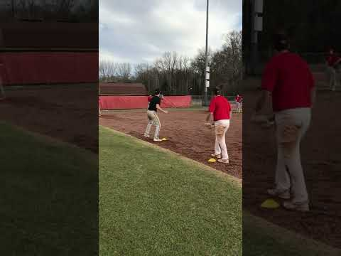
Practice Routines - Group (Triangle Drill)
“Baby” Backhand

Slide 13
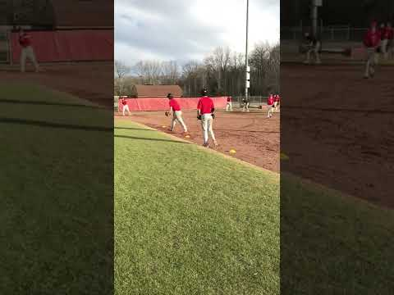
Practice Routines - Group (Triangle Drill)
“Fast One”

Slide 14
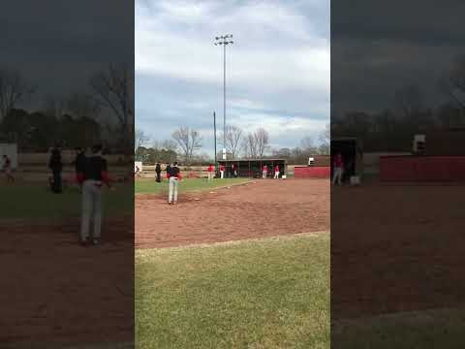
Practice Routines - Group (Triangle Drill)
“Extended” Backhand

Slide 15
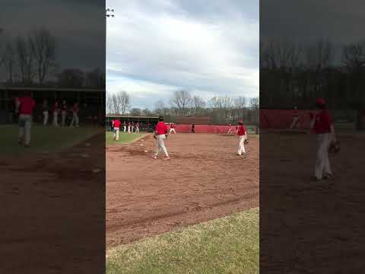
Practice Routines - Group (Triangle Drill)
“Regular”

Slide 16
Practice Routines - Group (Triangle Drill)
“Slow Roller”

Slide 17
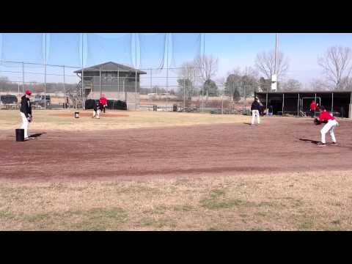
Practice Routines - Group (Bucket Feeds)
Double Play Focus
More intense throwing
“Feeds and Turns”
Rounds = 1 bucket of 36 balls
Rd 1 = 3B - 2B - 1B - Bucket
Rd 2 = SS - 2B - 1B - Bucket
Rd 3 = 2B - SS - 1B - Bucket
Rd4 = 1B - SS/2B - 1B (other 1B) - Bucket

Slide 18
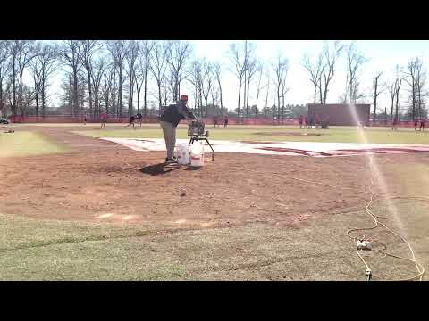
Practice Routines: Team (Round 1)
Machine Fungo (2 Man)
Hack Attack JR at home
OR Coach
3B/2B (right side)
SS/1B (left side)
2 rounds = 7 mins
Bucket at 1B and 2B
Rd 1
“Left Side 2, Right Side 1”
SS/1B feed 2B (pitcher)
3B/2B throw 1B (1B cover)
Rd 2
“Left Side 1, Right Side 2”
SS/1B throw 1B (1B/pitcher cover)
3B/2B feed 2B (pitcher)

Slide 19
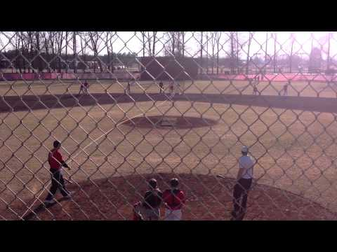
Practice Routines: Team (Round 1)
Machine Fungo (2 Man)
Hack Attack JR at home
OR Coach
3B/2B (right side)
SS/1B (left side)
2 rounds = 7 mins
Bucket at 1B and 2B
Rd 1
“Left Side 2, Right Side 1”
SS/1B feed 2B (pitcher)
3B/2B throw 1B (1B cover)
Rd 2
“Left Side 1, Right Side 2”
SS/1B throw 1B (1B/pitcher cover)
3B/2B feed 2B (pitcher)

Slide 20
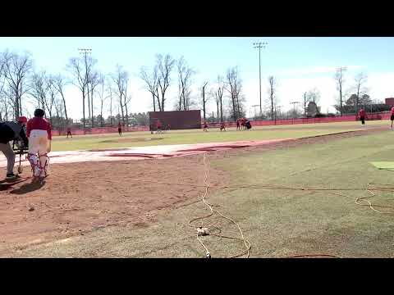
Practice Routines: Team (Round 2)
Machine Fungo (2 Man)
Hack Attack JR at home
OR Coach
3B/2B (right side)
SS/1B (left side)
2 rounds = 7 mins
Bucket at 1B and 2B
Rd 1
“Left Side 2, Right Side 1”
SS/1B feed 2B (pitcher)
3B/2B throw 1B (1B cover)
Rd 2
“Left Side 1, Right Side 2”
SS/1B throw 1B (1B/pitcher cover)
3B/2B feed 2B (pitcher)

Slide 21
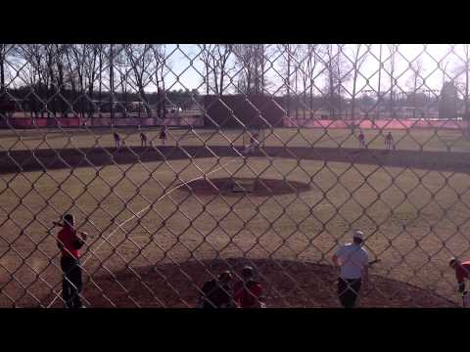
Practice Routines: Team (Round 2)
Machine Fungo (2 Man)
Hack Attack JR at home
OR Coach
3B/2B (right side)
SS/1B (left side)
2 rounds = 7 mins
Bucket at 1B and 2B
Rd 1
“Left Side 2, Right Side 1”
SS/1B feed 2B (pitcher)
3B/2B throw 1B (1B cover)
Rd 2
“Left Side 1, Right Side 2”
SS/1B throw 1B (1B/pitcher cover)
3B/2B feed 2B (pitcher)

Slide 22
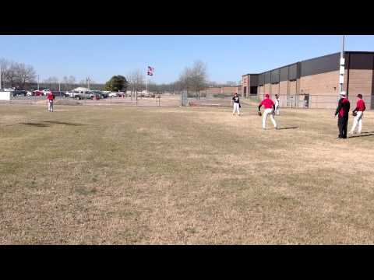
Practice Routines: Team
4 Corners Throwing
60 - 70 ft apart
All Infielders OR Infielders and Catchers
Rounds = 2-3 mins
Shuffle
Step-to
Pivot
Tags
“Roll to Left, Throw Across”
Regular
Catcher Throw down
Forehand
Backhand
Slow roller
Catcher Throw down

Slide 23
Practice Routines: Team
Fungo (Routine)
2 Coaches
3B/2B (right side)
SS/1B (left side)
3 min rounds
Rd 1 - INF in
Force Home
Tag Home
Catcher DP
Rd 2 - normal/pitcher on
5-4-3, 6-3, 3-1
Rd 3 - normal/pitcher on
5-3, 4-6-3, 3-6-3 or 1
Rd 4 - normal/pitcher on
5-3(back/fore), 6-4-3, 4-3, 1-6/4-3
Rd 5- normal/pitcher on (slow rollers)
5-3, 6-3, 4-3, Triangle, 3-2, 1-2
Triangle = slow between P, 2B, 1B
1-2 = Squeeze
SS - Tag - Coach
2B - 1B
Situational Fungo
Competition with Runners
Outfielders
Pitchers
Always a runner at Home
Outs vs. Runs
Outs = 1
Runs = 2
INFIELD IN ALL ROUNDS
3 minute rounds
Rd 1 - runners 3B
Less than 2 outs
Rd 2 - runner 1B and 3B
1 out
Rd 3 - bases loaded
Less than 2 outs

Slide 24
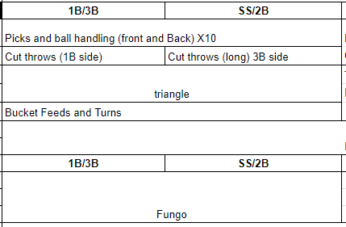
Practice Organization

