Slide 1
Outfield Skills and Drills
“Making the Complete Outfielder”

Slide 2
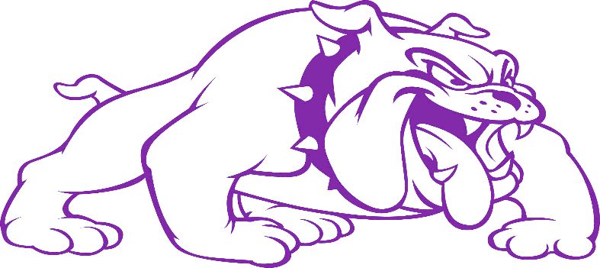
Daily Fundamental Series
Needs: Tennis Balls
Outfielders will be partnered with each other
Routine fly ball exchange- Emphasis on behind the ball and step to with glove side foot.
Routine ground ball- Emphasis on down in legs, eyes engaged, and proper footwork. (glove side foot front or back.)
Drop steps each way- Emphasis on really open drop steps and glove side turns.
False reads- Emphasis on quick head and shoulder turns while staying on the same line or stem.
Extras:
Figure four slide- start with ball in your glove hand, go into figure four slide- Emphasis on recovery after slide and catch.
Willie Mays- Over the shoulder cradle.-Emphasis on tracking and body control

Slide 3
Routine Work Through

Slide 4
Do or Die Footwork and Exchange

Slide 5
Drop Steps/False Reads

Slide 6
Willy Mays and Figure 4

Slide 7
Communication Circuit
Needs: At least 2 cones and 4 outfielders
Emphasis on change of direction, head and shoulder turns, and communication.
*Must appoint a priority line for these drills.
Drop step out-communication ball in
Flat line drive-back-communication ball
Recovery in and out

Slide 8
Communication: Out/In

Slide 9
Communication: Out/In

Slide 10
Communication: Flat Out/In

Slide 11
Communication: Flat Out/In

Slide 12
Recovery In/Out

Slide 13
Recovery In/Out

Slide 14
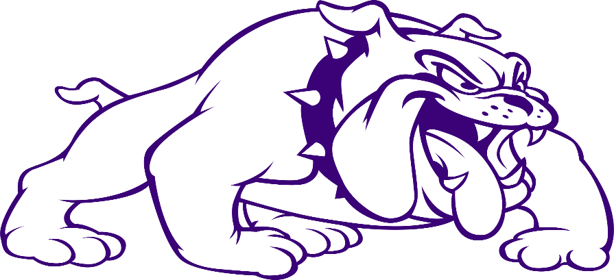
Change of Direction Drills
Needs: 4-6 cones and 4-6 outfielders
Emphasis on change of direction, head and shoulder turn, and eye tracking when tired.
Zig-Zag: Working on lateral change of direction, head and shoulder turn, and completing active play before the next.
W-Drill: Working on vertical change of direction

Slide 15
Zig-Zag Drill

Slide 16
Zig-Zag Drill

Slide 17
W-Drill

Slide 18
W-Drill

Slide 19
Zipline
Needs: cone per throwing location, base/screen target, and machine/fungo
Emphasis on driving long hops, directional throws, and do-or-die footwork.
First two cones are driven in the air practicing a routine hit that we are throwing to the cutoff man.
All cones after that are long hops.
Anytime they hit the target two times in a row as a unit they may move back on the “zipline.” Every time they miss two in a row they must move closer on the “zipline.” Any miss over the screen = start over

Slide 20
Zipline
Field Screen

Slide 21
Zipline

Slide 22
Trident
Emphasis on proper attack angles to create direction on our long hop throws.
Machine ground ball or fungo ground ball directly down the middle of the “runway”
One cone at a time will go and create a proper attack angle in order to create positive direction for their throw.
First two levels of trident can be in the air. After that only long hops count.

Slide 23
Trident
Field Screen

Slide 24
Trident

Slide 25
Around the World
Needs: cones for circle and machine/fungo
Emphasis is on correct angles/drop steps for attacking a fly ball.
Create a circle with cones. Larger circle for better skill sets
Shoot fly ball into the center of the target.
One player at a time will go.
Player will use the correct angle to work the ball and then move up to the next cone.

Slide 26
Around the World
Machine

Slide 27
Around the World

Slide 28
Indoor Drills
Needs: Baseballs, box, and tee.
Emphasis: Footwork, exchanges, and direction
Drills
Get behinds
Do or die footwork
Glove side turns to anchor
Pick ups

Slide 29
Get Behinds

Slide 30
Do or Die Footwork

Slide 31
Glove Slide Turn to Anchor

Slide 32
Pickups

Slide 33
Scott Gallagher
Scott.Gallagher@g.fayar.net
479-841-9219
Travis Hill
Travis.hill@g.fayar.net
501-813-7969
Alex Smith
Alexander.smith@g.fayar.net
979-864-6692

